Slide 1
Neural Networks
Corresponding code

Slide 2
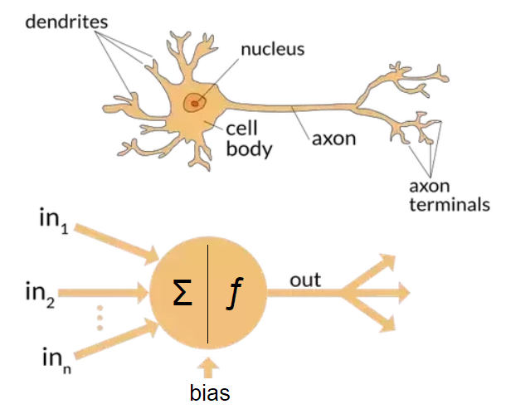
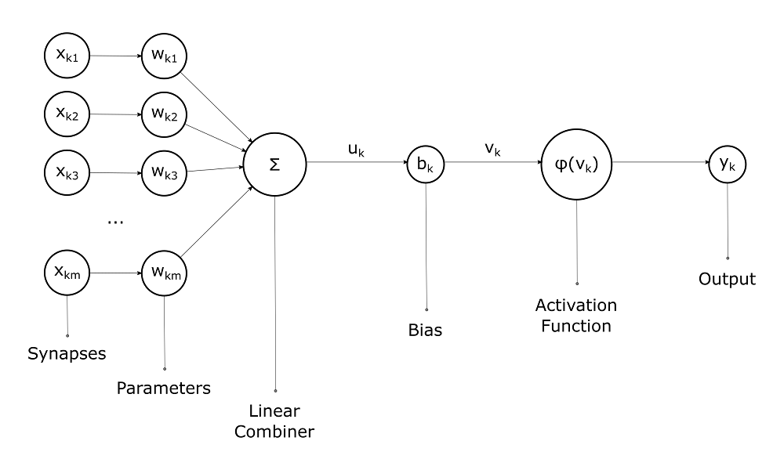
Building Blocks

Slide 3
3 Steps
1. Each input is multiplied by a weight:
x1 -> x1 * w1
x2 -> x2 * w2
2. All steps are added together with a bias.
sum = (x1*w1) + (x2*w2) + b
3. The summation is passed through an activation function.
y = f(sum)

Slide 4
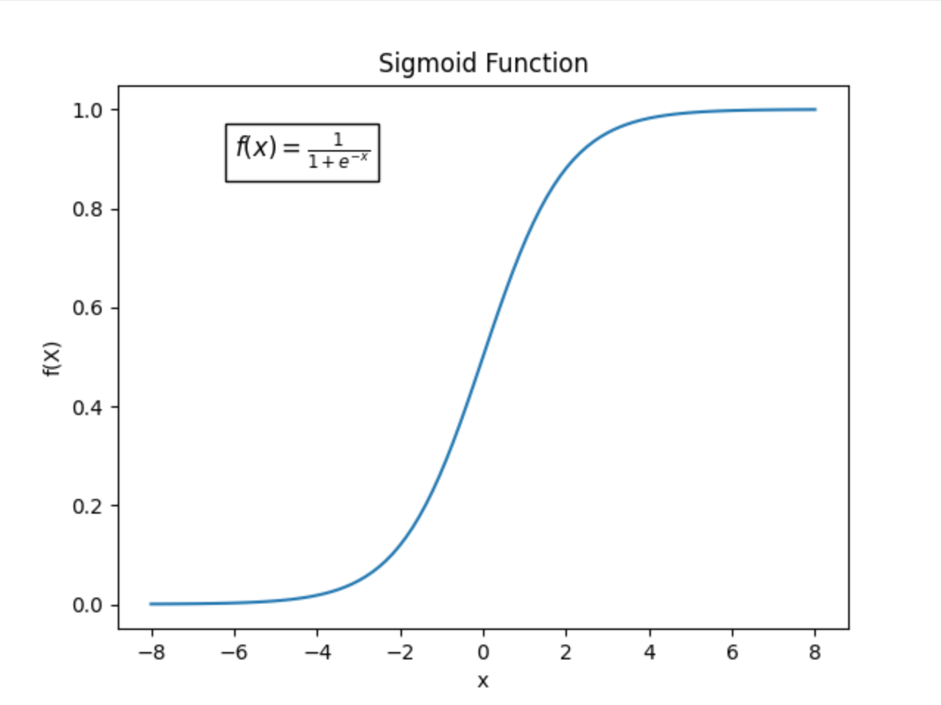
Activation Function
Used to turn some unbounded input into a nice predictable output.
One common activation function is the sigmoid function. You can see as input (x) approaches -∞, f(x) converges to 0. As x approaches ∞, f(x) converges to 1.

Slide 5
Example
Assume we have a 2-input neuron that uses the sigmoid activation function. Sigmoid calculator.
w = {0,1}
b=4
Let's give an input of x = [2,3]
sum = (x1*w1) + (x2*w2) + b
sum = 2*0 + 3*1 = 3 + 4 = 7
y = f(7) = 0.999
The process of passing inputs forward to get a result is called feedforward.
We can validate this result with our code implemented neural network.

Slide 6
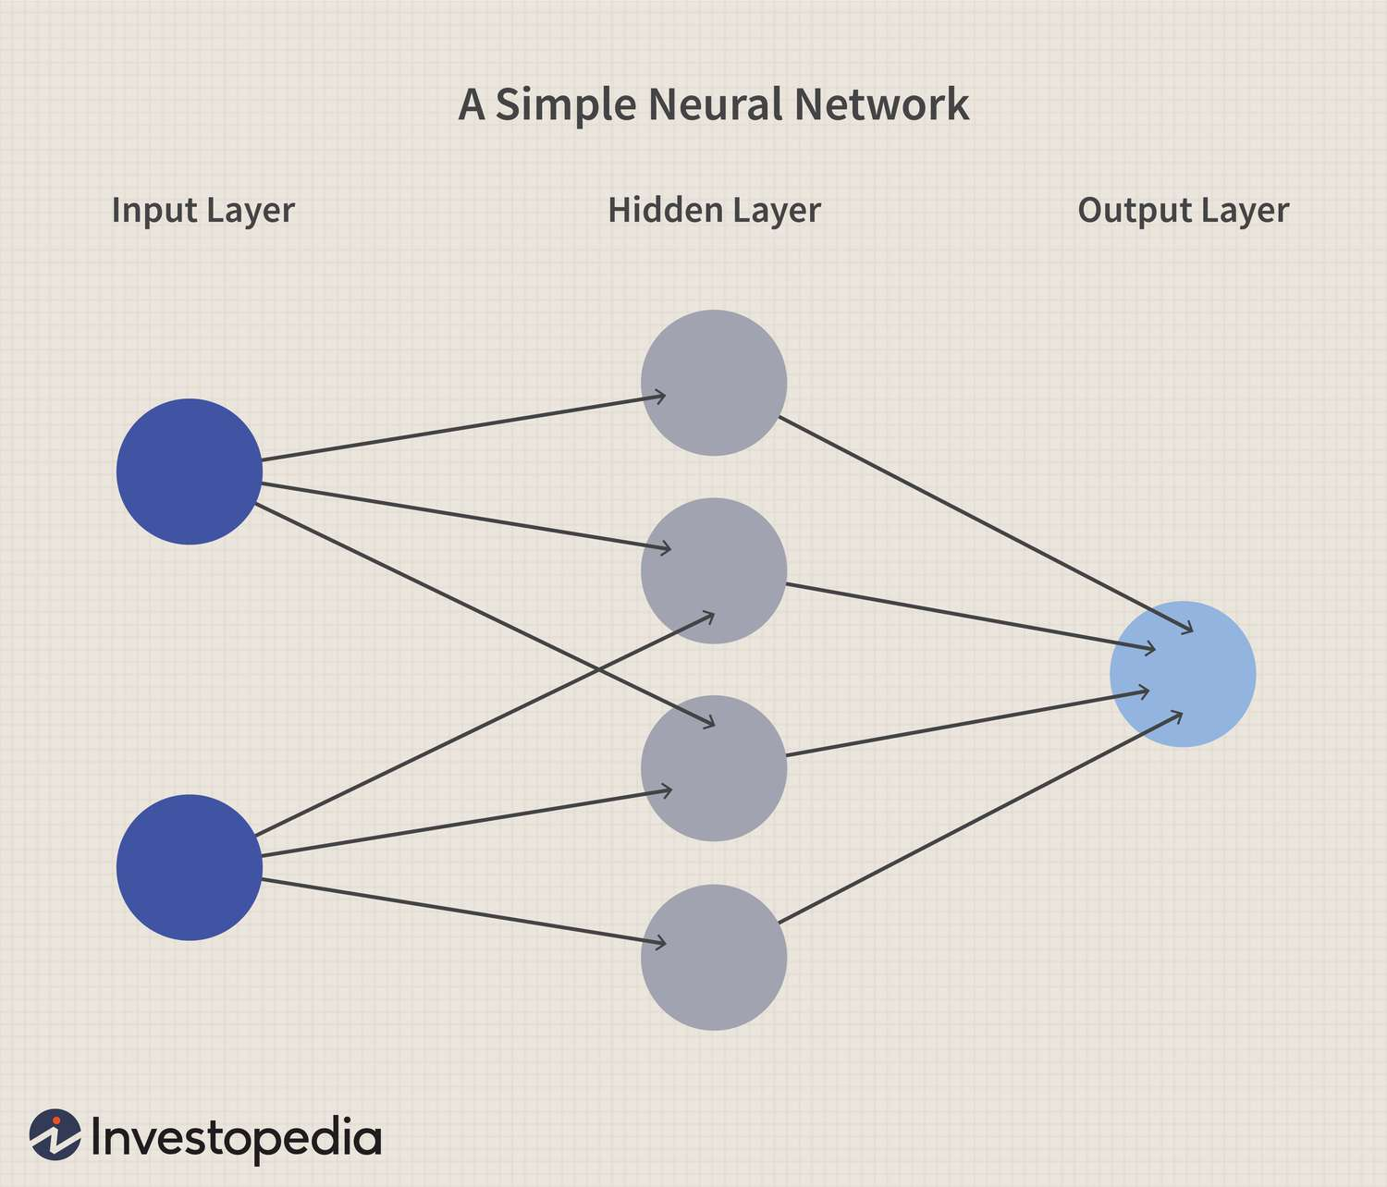
To form a neural network, combine neurons
This neural network has 2 inputs, a hidden layer of four neurons and an output layer with 1 neuron.
Notice the outputs of the hidden layer are in the inputs of the output layer.

Slide 7
Hidden Layers
Hidden layers are any layer between the input and output layers.
Neural networks can have many layers. If they have more than three layers, it is generally considered to be deep learning.

Slide 8
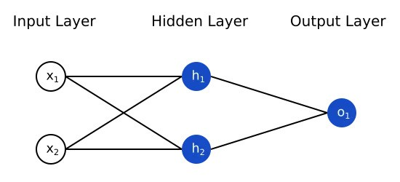
Feeding Forward
Let's assume all neurons have the weight of {0,1}, a bias of 0, and and use the sigmoid as their activation function.
If we pass in x={2,3}
We get h1 and h2 = f(w*x +b) = ((0*2)+(1*3)+0)=f(3) = 0.956
Then o1 = f(w*[h1,h2]+b) f(0*0.956 + 1*0.956 + 0) = f(0.956) = ~0.722

Slide 9
Training a basic neural network
Let's say we have the following table:
Name | Weight (kg) | Height (cm) | Gender
Jordan | 70 | 174 | M
Sally | 50 | 160 | F
Michael | 85 | 188 | M
Mae | 60 | 164 | F

Slide 10
Conversion
We will mark male as 1 and female as 0 and scale our weights. We will make 170cm the cut off for women in height and 65 kg the cut off. This is arbitrary.
Name | Weight (kg) | Height (cm) | Gender
Jordan | +5 | +4 | 1
Sally | -15 | -10 | 0
Michael | +20 | +18 | 1
Mae | -5 | -6 | 0

Slide 11

Defining "loss"
We need to define what good is so that we can define what better means
A loss function determines how well a neural network is at a particular task.
For our purposes, we will use the mean squared error error (MSE) loss function

Slide 12
MSE Loss Function
n is the number of samples. In our case, 4 people.
y represents the target of prediction, in our case gender.
ypred is the predicted gender, ytrue is the actual gender of the individual.
MSE therefore calculates the sum of all squares of the difference between the true value for gender and the predicted values for gender. Notice that if ytrue = ypred, then the difference will be 0, and thus MSE will be smaller. If the difference is 1 (the incorrect gender is predicted, then the summation grows and our error is larger.

Slide 13
The goal of training a network is to minimize loss
Less loss = more precision = better predictions
Notice that with small sample sizes incorrect predictions can wildly effect the MSE
Larger sample sizes means any individual loss is less noticeable as it is part of a larger sum.
Let's say our model always predicts that someone is a male (gender = 1) What would our loss be?
MSE = ¼ (0 + 1 + 0 + 1) = .25 * 2 = 0.5

Slide 14
How do we minimize loss?
We can think of the loss function as a function of weights and biases, since this is what controls ultimately the outputs of each layer, and ultimately how close we are to the final result.
How do we change the weights and biases in such a way to minimize loss, maximize accuracy without reverting to manual trial and error?
Calculus. Specifically, we want to calculate errors starting from the output node and moving backward. We use partial derivatives and the chain rule to do so.
Moving backwards from the output to other layers and calculating their partial derivatives is known as backpropagation.

Slide 15
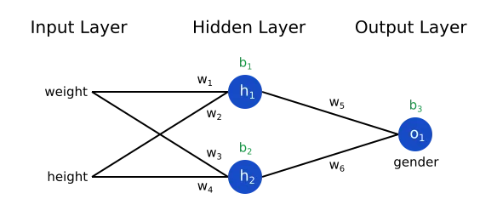
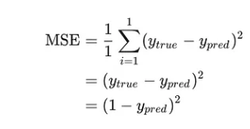
Backpropagation Example
Let's assume this is our network.
We can write the loss function as a multivariable function
L(w1,w2,w3,w4,w5,w6,b1,b2,b3)
Meaning, the loss function depends on all of these variables.
Let's start off with only one entry: Jordan.
MSE (L) for only Jordan would be reduced as follows.

Slide 16


Backpropagation Example Continued (1)
If we changed w1, how would it impact L?
is what we are looking for. (The rate of change of the loss function with respect to weight 1.
Because we know that the the Loss function depends on ypred, we can rewrite this derivative in the following way thanks to the chain rule.

Slide 17



Backpropagation Example Continued (2)
We know the Loss function in the context of Jordan is
Thus we can derive dL/dypred as such:
Now we need
We know w1 only impacts h1 from our network graph

Slide 18
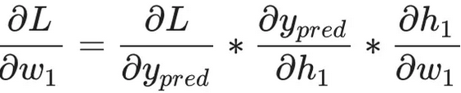


Backpropagation Example Continued (3)
We know ypred is impacted by h1, which in turn is impacted by w1. Thus we can expand our notation as such. We know dL/dypred already. We need the other two quotients now.
We know the way to calculate ypred is to look at the output from the output neuron o1, which depend on h1 and h2.
We know how to calculate the derivative of ypred with respect to h1. Now we need dh1/dw1 (the rate of change of h1 with respect to w1, ie if we change w1 how much does h1 change)

Slide 19
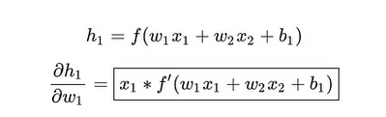
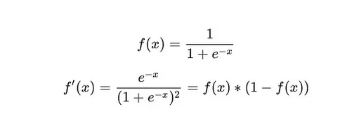
Backpropagation Final
We know how to calculate h1, and thus we can also calculate the rate at which it changes with respect to w1!
We know f is our activation function, which is a sigmoid. We also know the derivative of a sigmoid is as follows. (Can use Wolfram Alpha to confirm).

Slide 20

Let's calculate based on certain weights
For the sake of our example we will say all the weights are 0.50 and our bias is 0. Remember we are working with Jordan in our example.
h1 = f(w1*x1 + w2*x2 +b1)
h1 = f(5*0.50 + 4*0.50+ 0) = f(4.5) = .989
h2 = f(w3 * x1 + w4 * x1 +b1) = f(2.25) = .989
o1 = f(w5 * h1 + w6*h2 + b1) = (.50*.989+ .50*.989+ 0 ) = 0.989 so the model favors Jordan towards male (1)

Slide 21




Calculate backpropagation
-2 (1-0.989) = ~ -0.021
0.50 * f'(0.989) = 0.50 * 0.198 = 0.0985
5 * f'(0.989) = 5 * 0.198 = 0.985
-0.021 * 0.0985 * 0.985 = −0.002
This tells us that if we increase the weight (w1), our loss function would decrease, meaning it would more affirmatively label Jordan a male.
Note: I use this sigmoid calculator which tells me f'(x)

Slide 22
We can confirm this result.
For the sake of our example we will say all the weights are now 1 (double the weight of last time) and our bias is 0.
h1 = f(w1*x1 + w2*x2 +b1)
h1 = f(5*1 + 4*1+ 0) = f(9) = .999
h2 = f(w3 * x1 + w4 * x1 +b1) = f(9) = .999
o1 = f(w5 * h1 + w6*h2 + b1) = (1*.989+ 1*.989+ 0 ) = 1.98. We can see the model only is more confident that Jordan is a male.

Slide 23
Wouldn't it be great if we could optimize this procedure?
We can. In our example, we can use a gradient descent algorithm. GDA's don't work on everything though, so know their limitations!
There are a couple different types of gradient descent algorithms.
Stochastic gradient descent is when we input one training example at a time.
Mini-batch gradient descent is when we input more than 1 but less than the entire training set
Batch gradient descent is when we use the entire training set for backprop
In small datasets, you can get away with batch gradient descent, but this becomes computationally expensive if we do it on large datasets, so we often stick to stochastic gradient descent or mini-batch. Why is it expensive?

Slide 24
Why is batch gradient descent expensive?
Each time we have to update the weights and biases accordingly, we would have to process the entire dataset.. if we are talking about millions, billions, or trillions of rows of data and we have to process this set quite a few times to optimize the weights to minimize loss, well that's pricey.
Requires more memory per update. If we need to update all of the weights and biases and process our entire dataset each time, this is going to use a lot of memory. For some datasets (in the GBs or TBs even) this is untenable.
The noise we might get from stochastic gradient descent because we are updating them by feeding one sample at a time can actually be beneficial to us in avoiding overfitting, which is another propensity of batch gradient descent. Overfitting is discovered after training and must be addressed, and thus is time expensive.

Slide 25
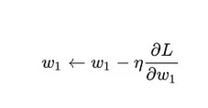
Updating our weights
We can write the general process of updating our weights as the equation to the left.
η is a constant called the learning rate that controls how fast we train.
All we’re doing is subtracting η ∂w1/​∂L​ from w1​.

Slide 26
Training
Choose one sample from our dataset. This is what makes it stochastic gradient descent — we only operate on one sample at a time.
Calculate all the partial derivatives of loss with respect to weights or biases (e.g. ∂L/∂w1​, ∂L​/∂w2​, etc).
Use the update equation to update each weight and bias.
Go back to step 1.

Slide 27
Epochs
a hyperparameter (not inherent to the model/algorithm) something we can modify which changes the results
a cycle of training. For stochastic gradient descent, this means we forward-fed and back propagated all of our training samples at least once.
Eventually, you hit diminishing returns with more epochs. At some point you've reached your limit on optimization.
In our example, we will start off with 1,000 epochs.

Slide 28
End of Lesson 1

Slide 29
Two Main Types of Neural Networks
Feedforward Neural Networks
Simplest type, not circular, one directional. We implemented one. They do not care about the order of information nor about storing memory. They are used for regression and classification tasks.
Recurrent Neural Networks (RNN)
Designed for sequential data processing tasks like natural language processing or interpreting time series data where memory of past events is important.

Slide 30
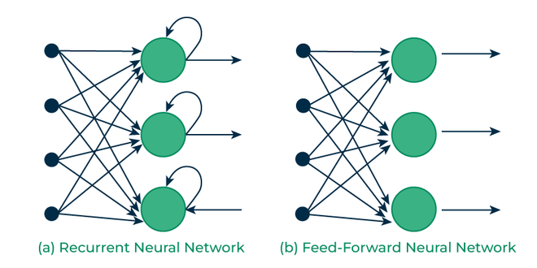
FNNs vs. RNNs

Slide 31
A Few More Types of Neural Networks
Convolutional Neural Networks (CNN)
A FNN that transformed Computer Vision tasks. Uses layers, basically filters to process information.
Long Short-Term Memory
A type of RNN that excels at capturing long term information, widely used in deep learning applications.
Autoencoders
Uses two functions: an encoding function to represent higher level data, and a decoding function to get that higher level data back from its simplified representation. Generally they are feedforward, but there are recurrent ones as well. Represents our data without the need for labels. Often used in facial recognition, anomaly detection, etc.
Generative Adversarial Networks (GANs)
Consists of two models: a generator and a discriminator. The two models train together until the generator can fool the discriminator at least half the time. A really famous case of GAN use is this.
Transformers
An RNN that is used to solve sequence transduction- ie given an input, give me its transformed output. Example: translating from English to Bosnian. Found often in text-to-speech, translation, and in special cases like GPT- to generate content based on questions (GPT stands for generative pre-trained transformer)

